Slide 1

FOOD SAFTEY PREDICTION USING ML
ADITYA ENGINEERING COLLEGE(A)
Batch No :A10
Under the Guidance of
Mr. M. Kalyan Ram , MCA, M.Tech(PhD).
Associate Professor
Department of CSE
Aditya Engineering College (A)
Surampalem.
Presented By
1. V.SUDHEETHI (19A91A0559)
2. N.R.L.VINEELA (19A91A0538)
3. M.JESSICA (19A91A0536)

Slide 2
Contents
Abstract
1.Introduction
1.1 Problem Statement
1.2 Aim & Objective of Project
1.3 Literature Survey Comparison Table
1.4 Existing system
1.5 Proposed system and Advantages
2.Requirement Analysis (SRS/HRS)
3.UML Diagrams
4. Architecture Diagram
5.Modules
6.Technology/Algorithm Used

Slide 3
ABSTRACT
Aiming to increase the shelf life of food, researchers are moving toward new methodologies to maintain the quality of food quality as there is more spoilage of food due to several other reasons like humidity, temperature and variety other influences.
As a result, efficient food spoilage tracking schemes are required to maintain the food quality levels.
Machine learning has proven to be useful technology for data analysis and modelling in a wide variety of domains, including food science and engineering.

Slide 4
INTRODUCTION
Machine learning (ML) is a relatively new method that has been proven to be capable of combining various types of data, including structured data and unstructured data in this case relating to the presence of food safety hazards to make predictions about food safety.
With ML, computers are programmed to “learn” from input data available to them. Learning is the process (based on a learning algorithm) of converting the input of experience (e.g., historical data) into the output of expertise (e.g., classification and prediction) .
demonstrating ML modeling is a promising tool for addressing the task of food safety monitoring and prediction.
To facilitate the application of ML within the context of food safety monitoring and prediction, and to provide insight for future studies.

Slide 5
AIM & OBJECTIVE
Aim:
The main aim of our project is to design a Web page that monitors and predicts the food safety easily.
Objective:
We will create a simple logistic regression model to predict the food safety of food.
Then we will develop a web application that takes the input to predict the safety of food.
Create a machine learning model using logistic regression in collab or by using spyder.
Create a login, Registration, Home and prediction web pages using HTML and CSS.
Develop the web application with flask and PyCharm and integrate the model in the App.

Slide 6
LITERATURE SURVEY
S.No | Reference Paper Title | Purpose | Drawbacks
1 | An Innovative Machine Learning Approach to Predict the Dietary Fiber Content of Packaged Foods | KNN can be used to predict the fiber content of Australian packaged foods and beverages based on commonly available nutrient information | These predictions can be used to monitor fiber in the Australian packaged food supply. the applicability of the KNN fiber prediction algorithm to countries with different packaged food systems is unknown.
2 | Machine Learning Prediction of Food Processing | introduce a machine learning algorithm that accurately predicts the degree of processing for any food, indicating that over 73% of the U.S. food supply is ultra-processed. | reports representative nutritional average values for each food/drink, which do not capture the variability due to factors such as recipe variations, production methods, soil quality, and storage time
3 | An Innovative Machine Learning Approach to Predict the Dietary Fiber Content of Packaged Foods | have shown the possibility of using neural networks,the advanced version of ML, to predict the carbohydrate, protein, and sodium content of packed foods based on their ingredients | This model failed to show the fiber content in the packed food . Which is an important component.
4 | Food Consumption and its impact on Cardiovascular Disease: Importance of Solutions focused on the globalized food system | major challenge is to identify and implement effective food systems and solutions and evaluate the national and local level policy actions underway to improve our diets. | provides a well-tested healthy dietary pattern only to reduce Cardiovascular Disease.

Slide 7
EXISTING SYSTEMS:
KNN can be used to predict the fiber content of Australian packaged foods and beverages based on commonly available nutrient information.
Additionally Maetal (2021) have shown the possibility of using neural networks to predict the carbohydrate, protein, and sodium content of packed foods based on their ingredients.
DISADVANTAGES:
These predictions can be used to monitor fiber in the Australian packaged food supply. the applicability of the KNN fiber prediction algorithm to countries with different packaged food systems is unknown.
However, despite the importance of fiber as part of a healthy diet, machine learning techniques have not yet been applied to the prediction of fiber content in packaged foods.

Slide 8
PROPOSED SYSTEM:
Costumer understanding of food quality and the ultimate concern for health and food safety force actors in agribusiness and food industry to use quality management as a strategic issue in innovation and production.
So we try to provide a solution to this issue by creating a Machine Learning Web Application that assess the safety of the food.
In the Back-End we use Python with ML , front-end with HTML,CSS etc .Both of these are connected by using framework called Flask.

Slide 9
ADVANTAGES:
Avoid the risks of food poisoning or any harmful effects for the customers
Increase the food’s safety and quality.
it helps to protect consumer from the risk of food borne illnesses.
It also helps to prevent consumers from risks of health –related conditions such as allergy and even death.

Slide 10
System Requirements
Hardware Requirements:
Processor : Dual Core
Ram: Above 60 GB
Software Requirements:
Frontend : Html,CSS
Backend:python
Framework : Flask
Libraries : numpy, scikit learn,pandas etc,.
IDE: PyCharm 2020 , VS code , spyder.

Slide 11
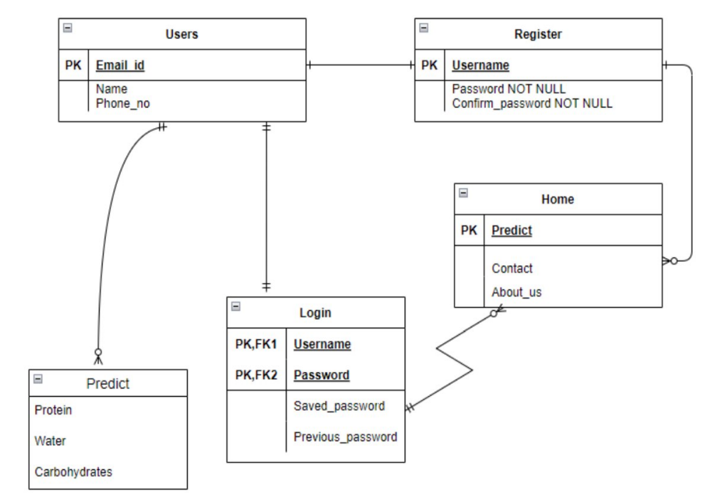
E-R DIAGRAM

Slide 12
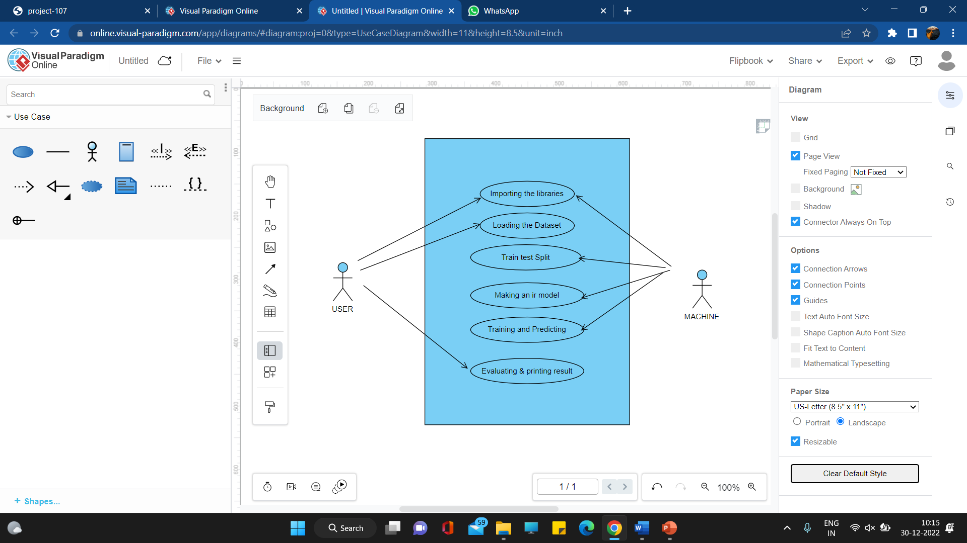
USE CASE DIAGRAM

Slide 13
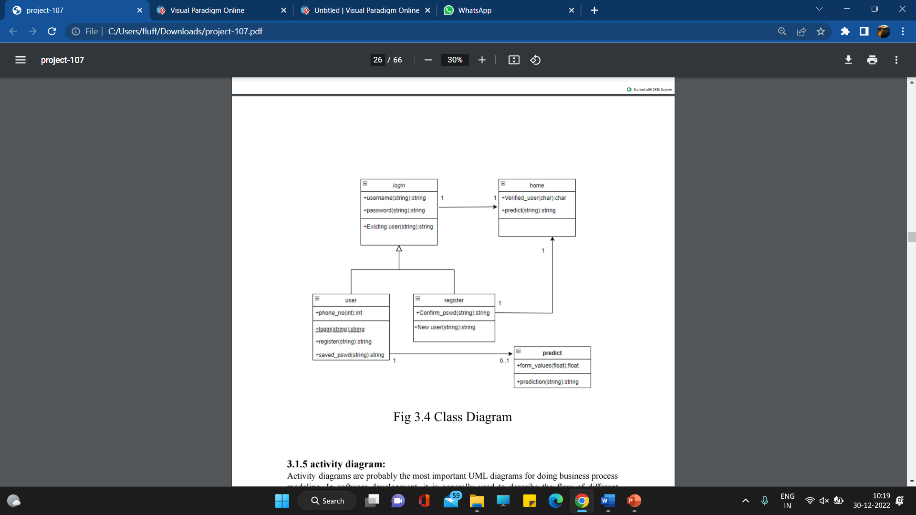
CLASS DIAGRAM

Slide 14
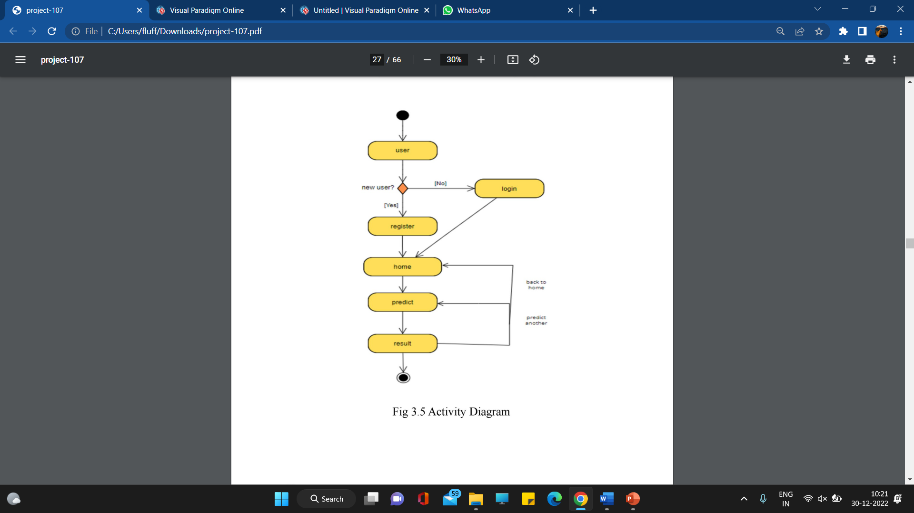
ACTIVITY DIAGRAM

Slide 15
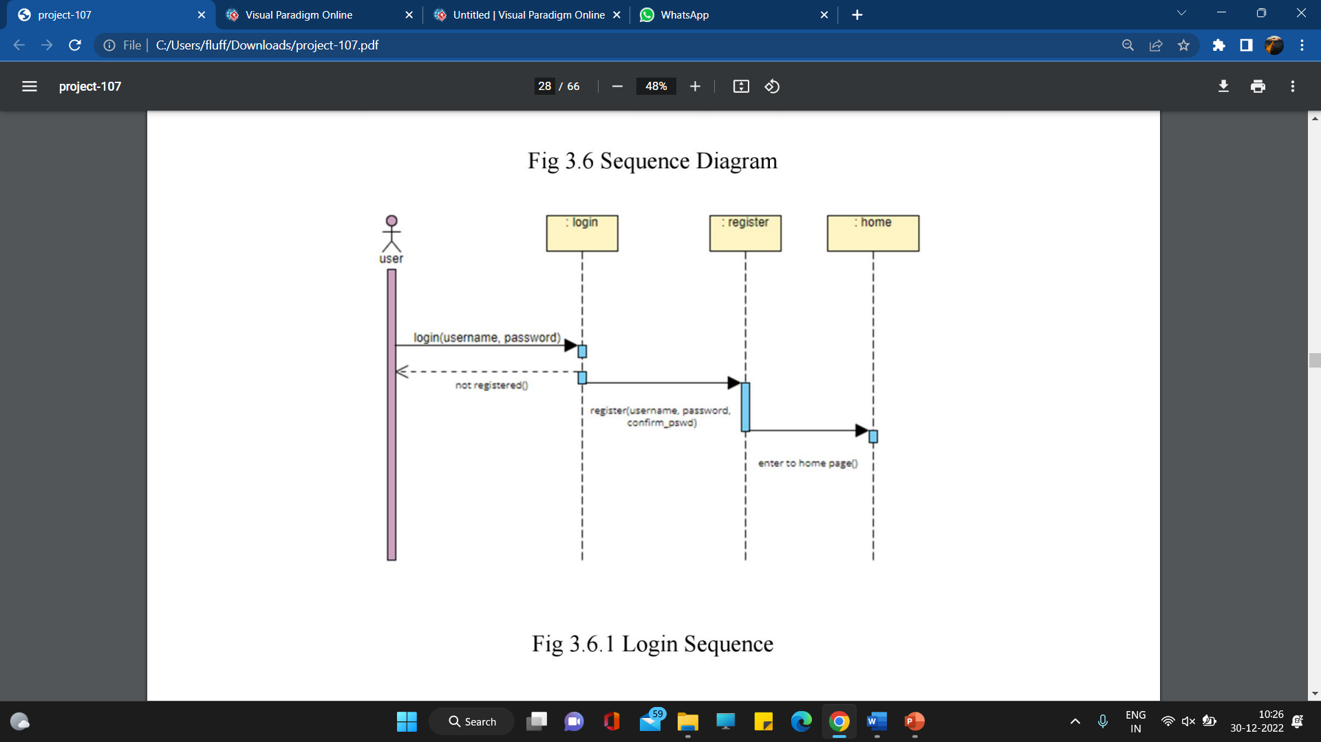
SEQUENCE DIAGRAM login sequence diagram

Slide 16
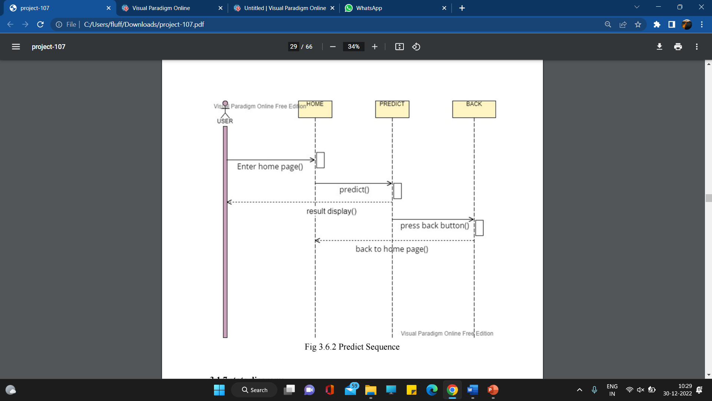
Predict sequence

Slide 17
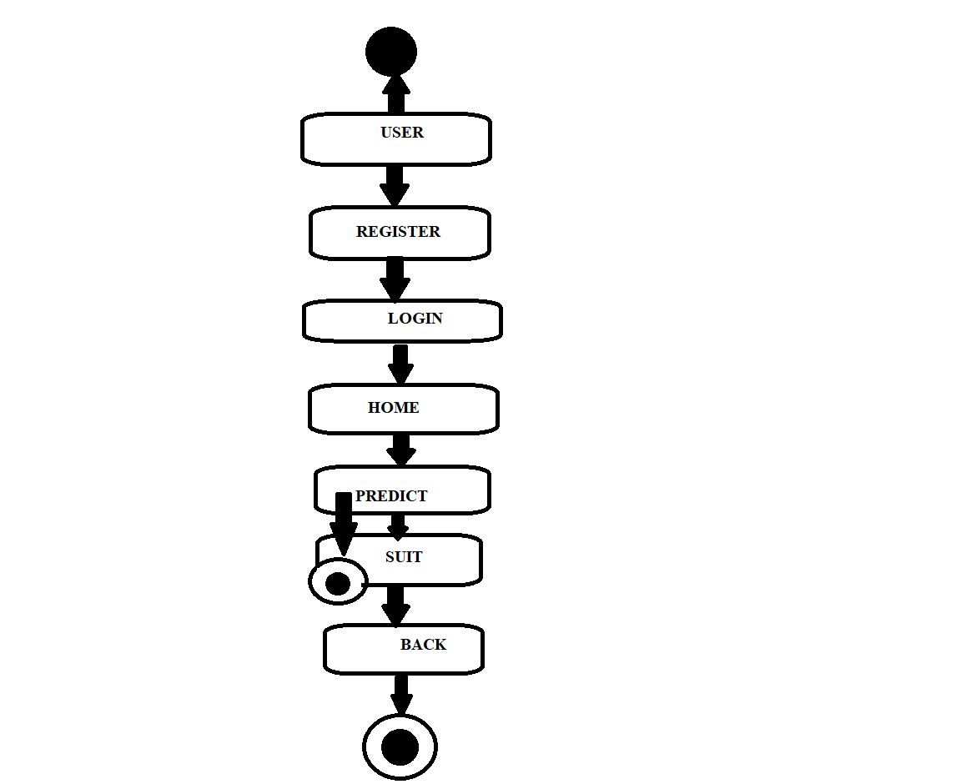
ARCHITECTURE

Slide 18
Packages used in python:
NumPy:
NumPy is a general-purpose array-processing package. provides a high-performance multidimensional array object, and tools for working with these arrays
It is the fundamental package for scientific computing with Python.
It is open-source software.

Slide 19
2. Pandas :
Pandas is an open-source library that is made mainly for working with relational or labelled data both easily and intuitively.
It provides various data structures and operations for manipulating numerical data and time series.
This library is built on the NumPy library. Pandas is fast and it has high performance & productivity for users.

Slide 20
3. Pickle Module:
Python pickle module is used for serializing and de-serializing a Python object structure.
Any object in Python can be pickled so that it can be saved on disk.
Pickling is a way to convert a python object (list, dict, etc.) into a character stream.
We import it by using : import pickle

Slide 21
4. Scikit- learn
Scikit-learn (Sklearn) is the most useful and robust library for machine learning in Python.
It provides a selection of efficient tools for machine learning and statistical modeling including classification, regression, clustering and dimensionality reduction via a consistence interface in Python.
This library, which is largely written in Python, is built upon NumPy, SciPy and Matplotlib.

Slide 22
MODULES
Data Collection
Data Preprocessing
Splitting the data into training and testing
Algorithm implementation on training dataset
Accuracy score on test dataset
Making the predictions with the model

Slide 23
Data collection:Data acquisition is the process of automatically collecting information from analog and digital units. It is under the test such as sensors and other devices.
It can achieve a flexible and user-defined measurement system.
Students and enthusiasts can practice applied machine learning techniques or exploratory data analysis with Kaggle free datasets.
These databases come from multiple sources, including reputable companies, government agencies, and data scientists

Slide 24
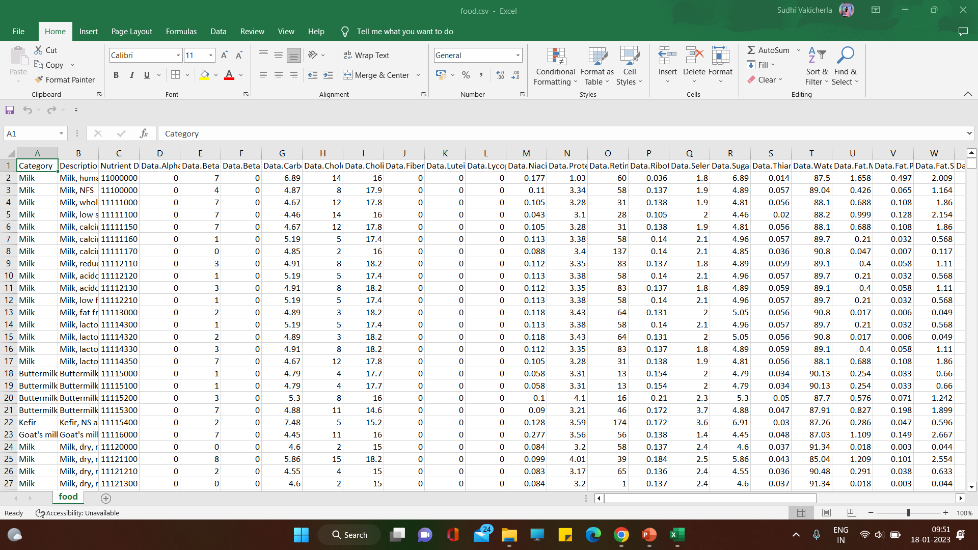

Slide 25
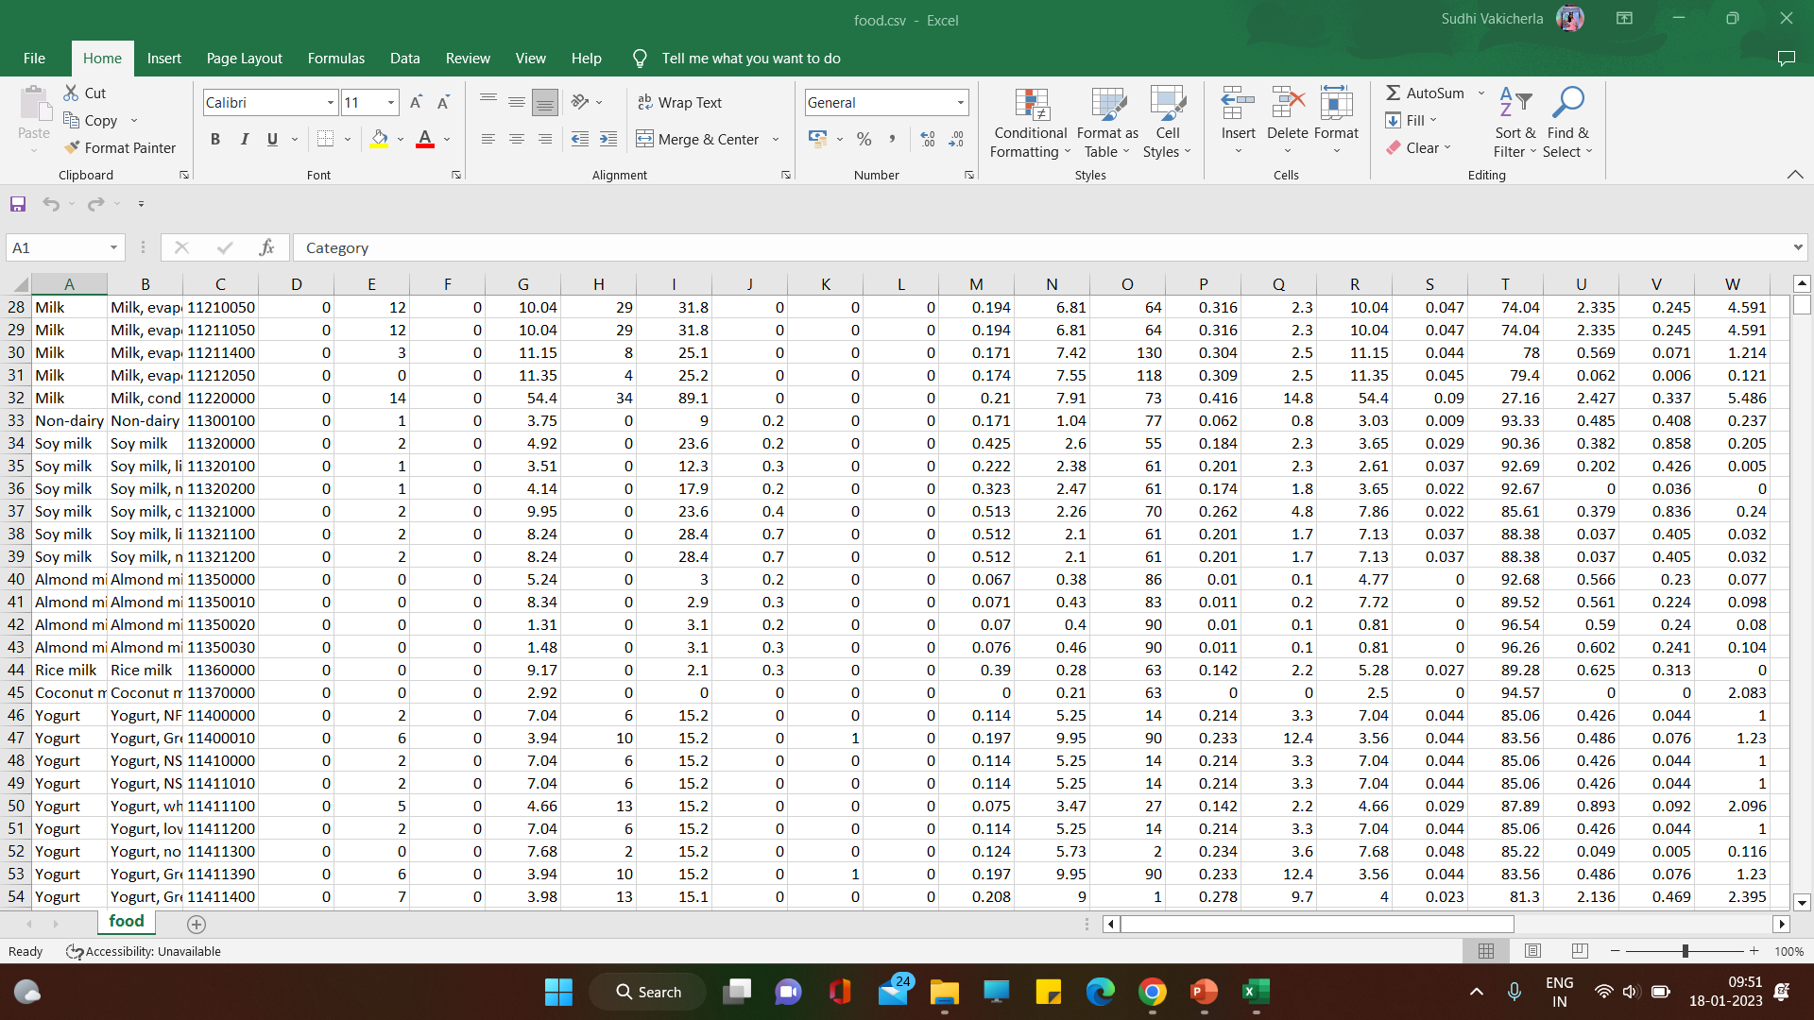

Slide 26
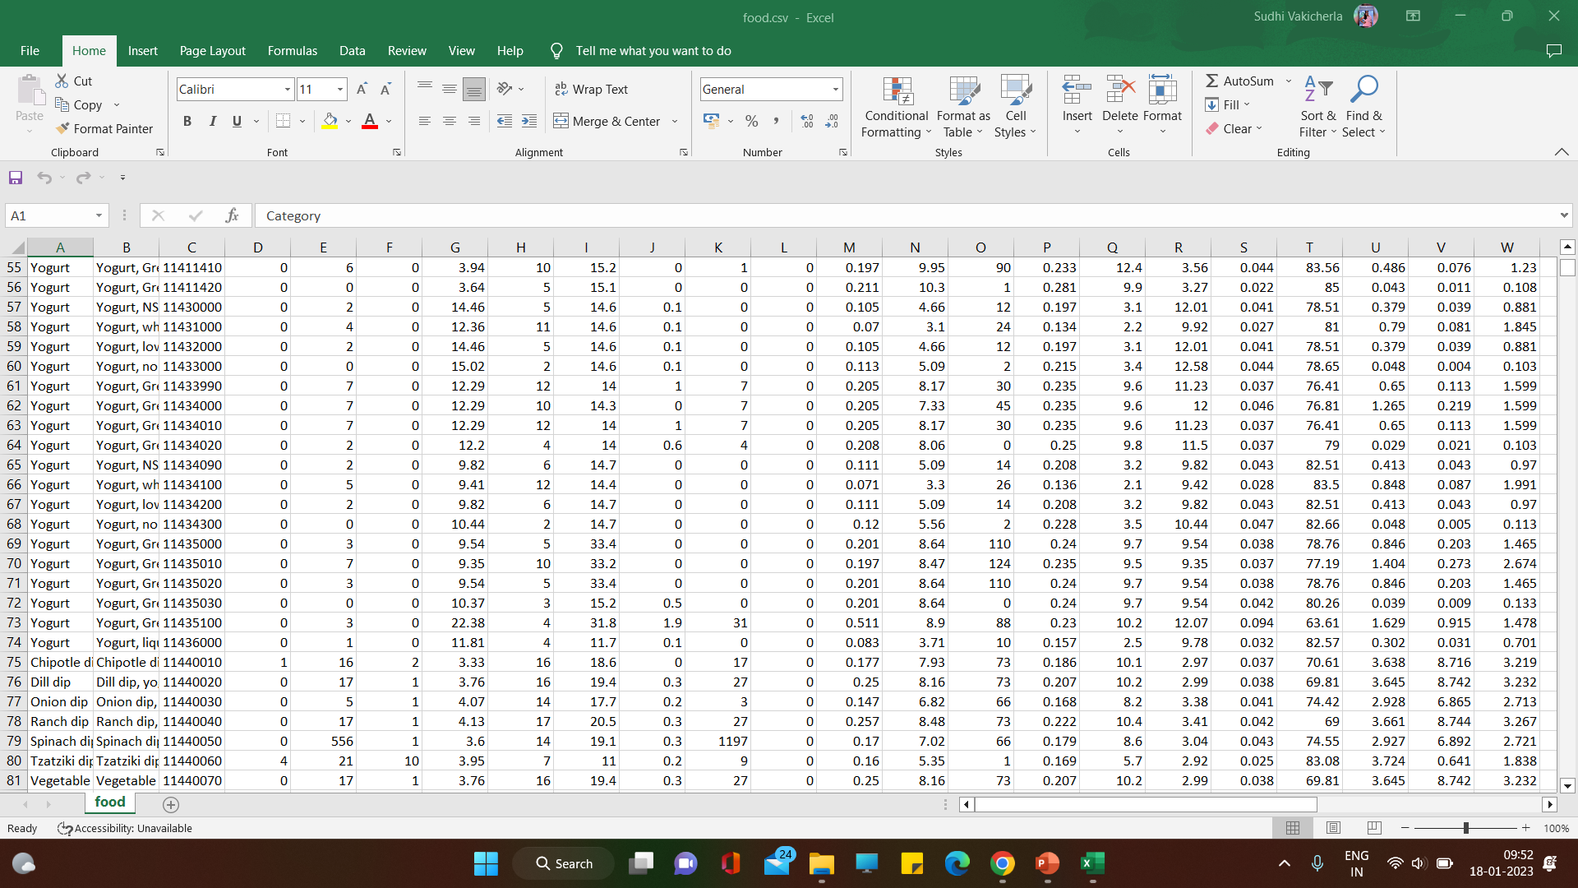

Slide 27
Data Pre-processing:Data preprocessing is a process of preparing the raw data and making it suitable for a machine learning model.
It is the first and crucial step while creating a machine learning model.
A real-world data generally contains noises, missing values, and maybe in an unusable format which cannot be directly used for machine learning models
It also increases the accuracy and efficiency of a machine learning model.

Slide 28
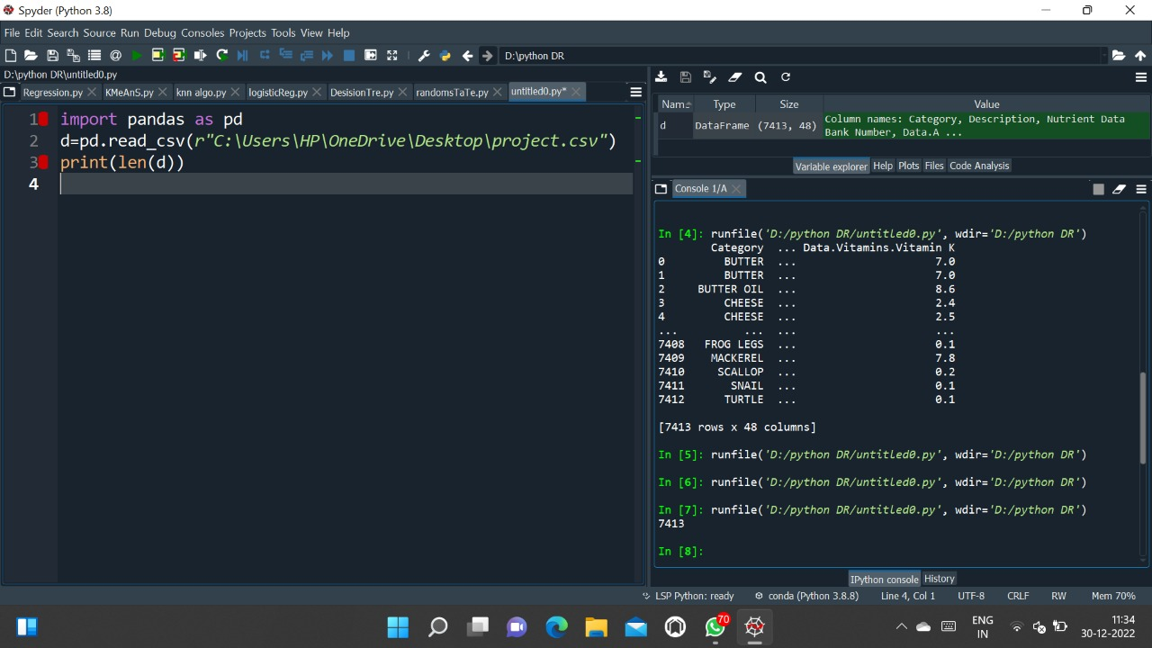

Slide 29
Splitting the data into training and testing: by doing this, we can enhance the performance of our machine learning model.
If we train our model very well and its training accuracy is also very high, but we provide a new dataset to it, then it will decrease the performance
Training Set: A subset of dataset to train the machine learning model, and we already know the output.
Test set: A subset of dataset to test the machine learning model, and by using the test set, model predicts the output.
For splitting the dataset, we will use the below lines of code:

Slide 30
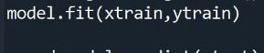
Algorithm implementation on training dataset:
The dataset will be trained with the machine learning algorithms, Logistic Regression (LR)

Slide 31
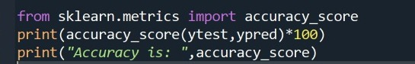
Accuracy score on test dataset:
Accuracy score in machine learning is an evaluation metric that measures the number of correct predictions made by a model in relation to the total number of predictions made.
We calculate it by dividing the number of correct predictions by the total number of predictions.

Slide 32
Making the predictions with the model:
Depending on the accuracy of the machine learning algorithms, the algorithm with most accuracy will be used to predict the food to be consumed or not.

Slide 33
Technology/Algorithm Used
Logistic regression streamlines the mathematics for measuring the impact of multiple
variables (e.g., age, gender, ad placement) with a given outcome (e.g., click-through or
ignore.
The resulting models can help tease apart the relative effectiveness of various interventions for different categories of people, such as young old or male/female.
Logistic models can also transform raw data streams to create features for other types of Al and machine learning techniques.
In fact, logistic regression is one of the commonly used algorithms in machine learning for binary classification problems, which are problems with two class values, including predictions such as "this or that," "yes or no”

Slide 34


Slide 35
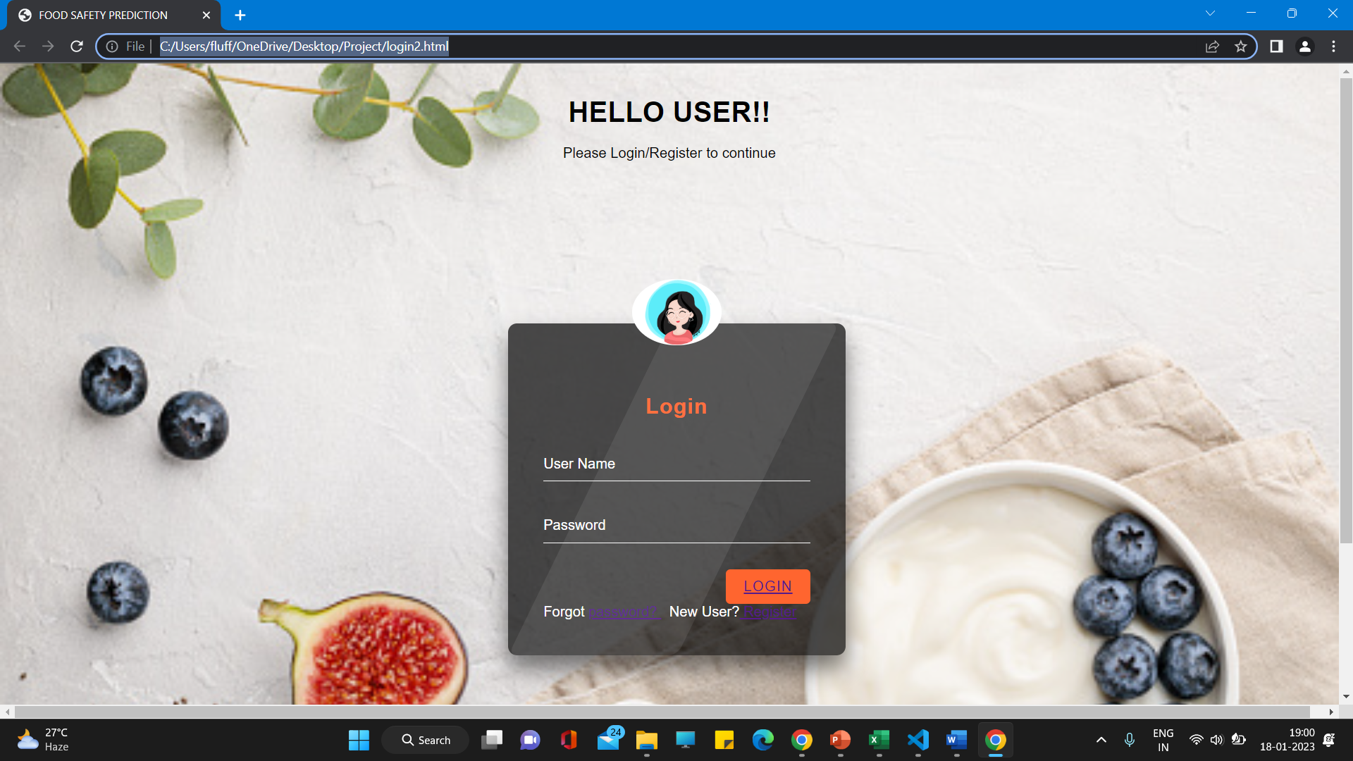
Login Page:

Slide 36
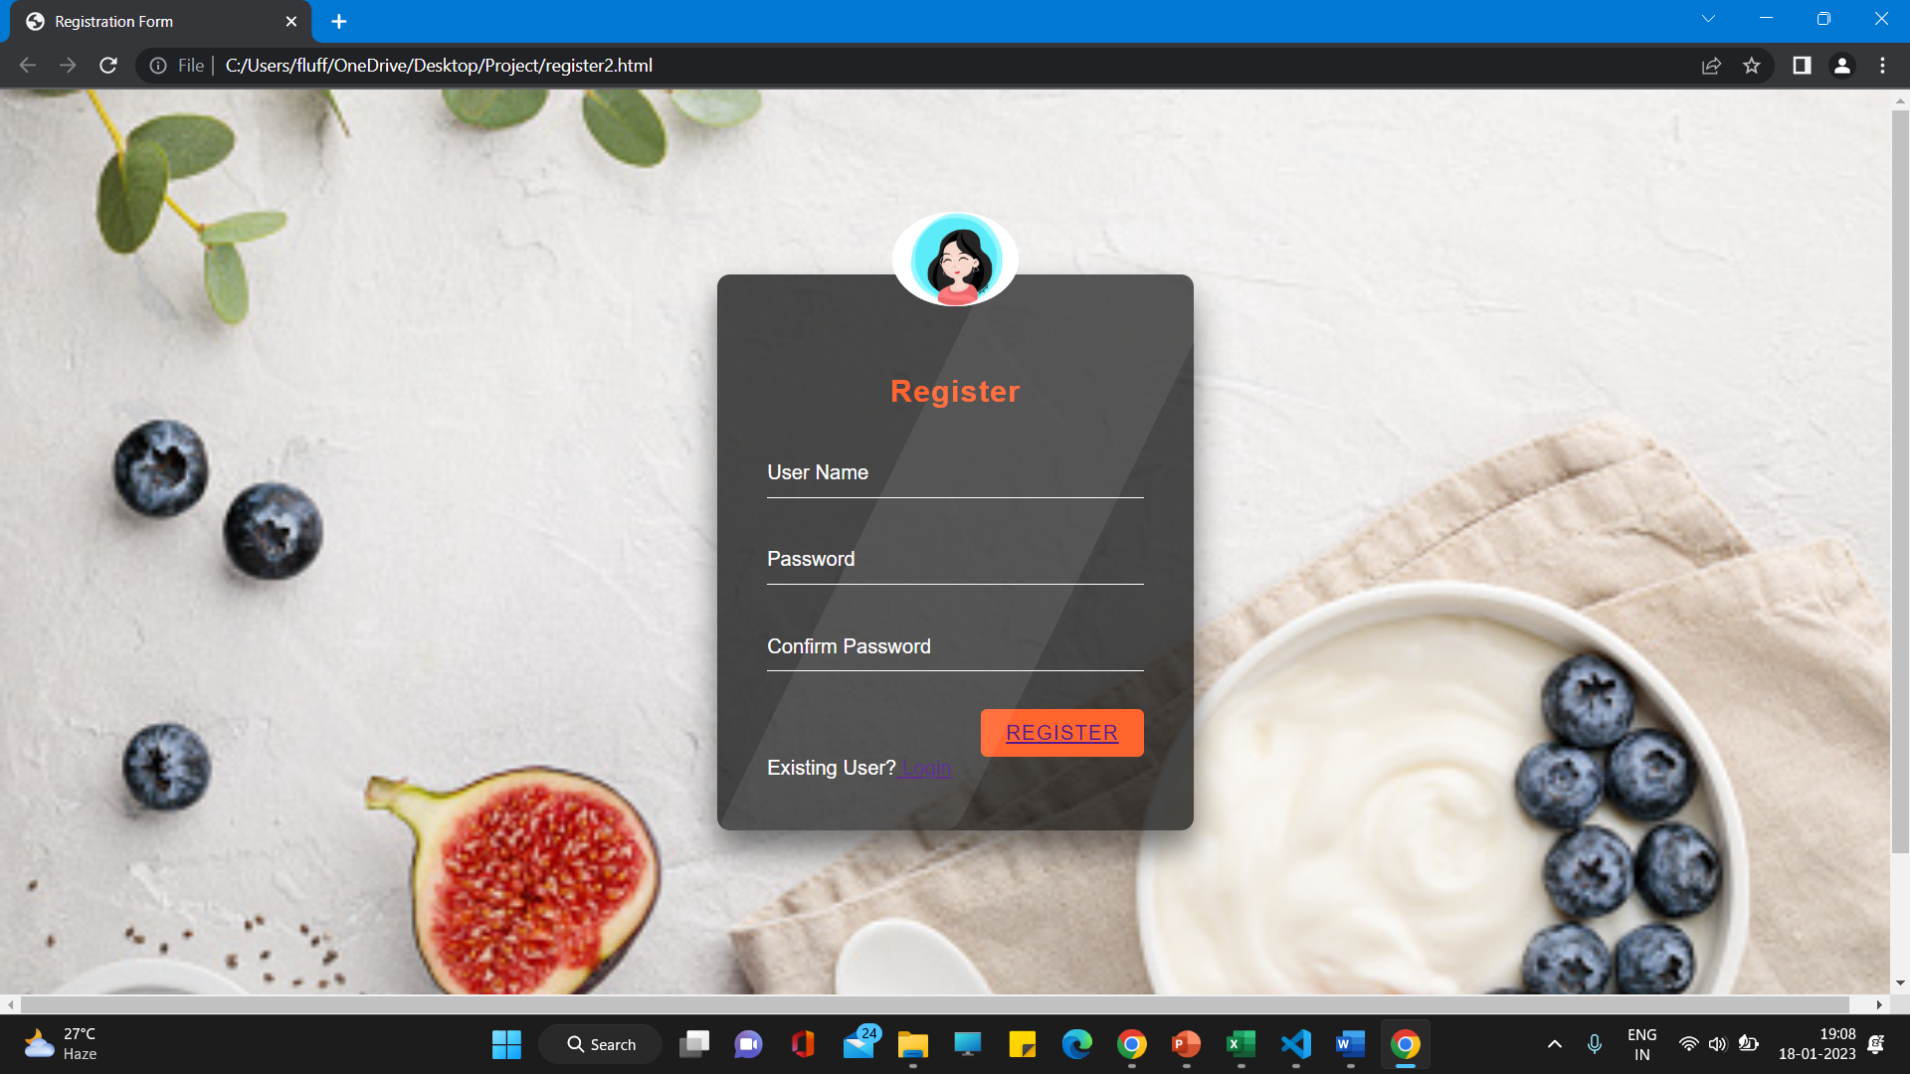
Register page:

Slide 37
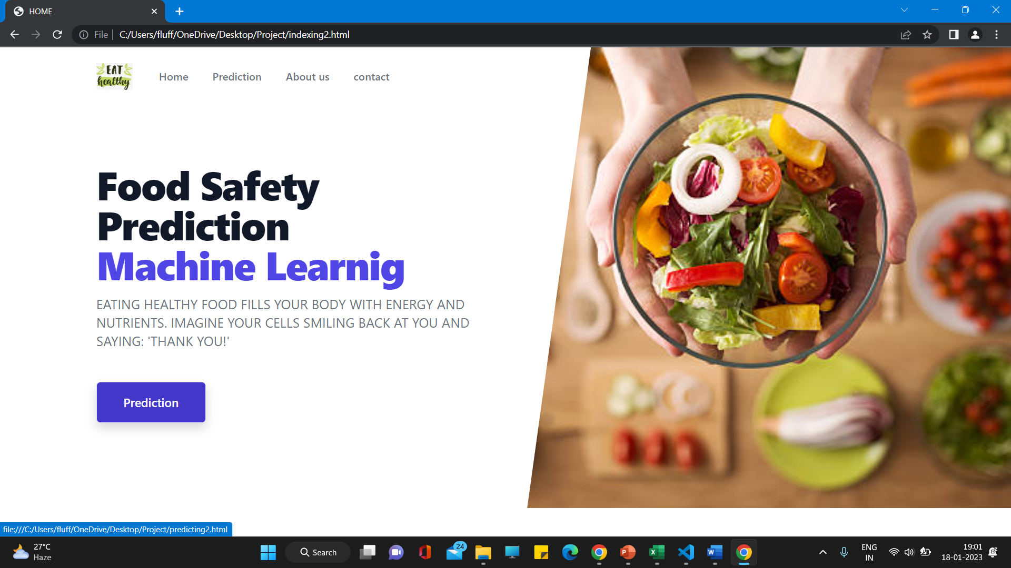
Index Page:

Slide 38
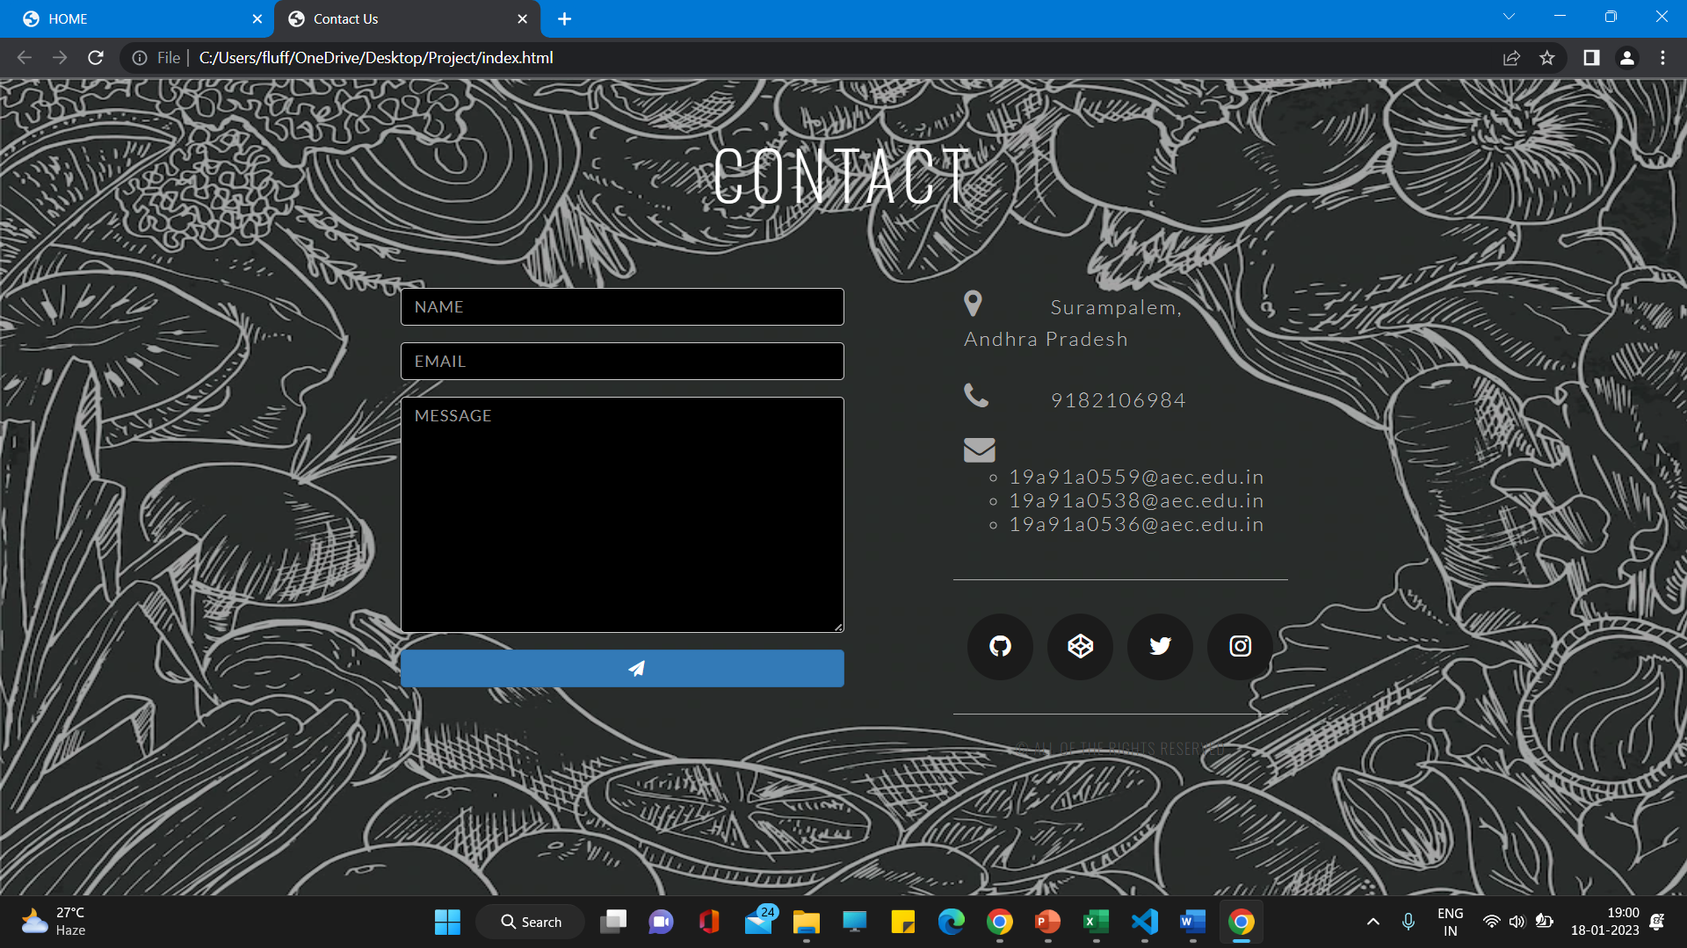
Contact Us page:

Slide 39
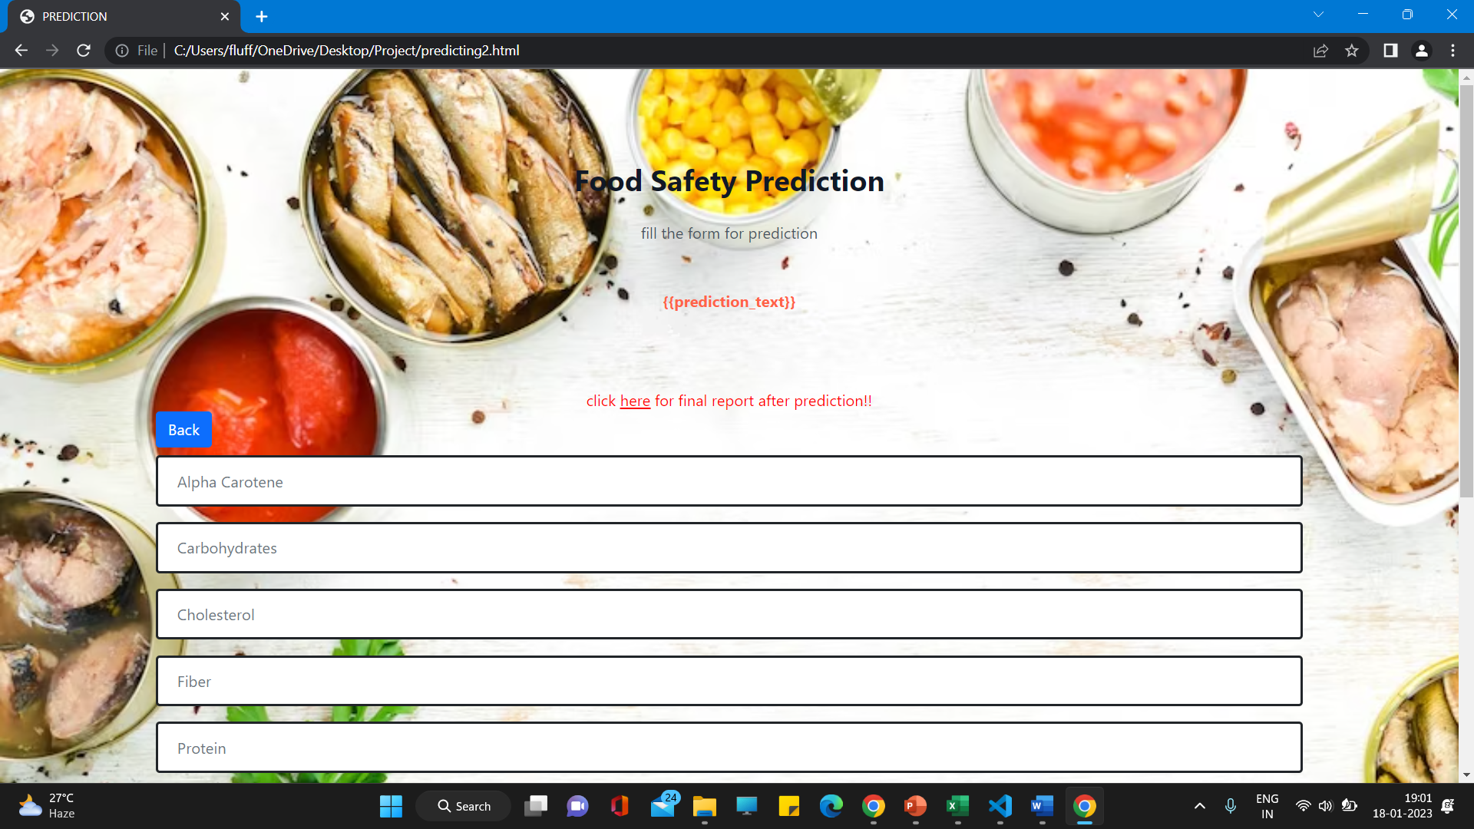
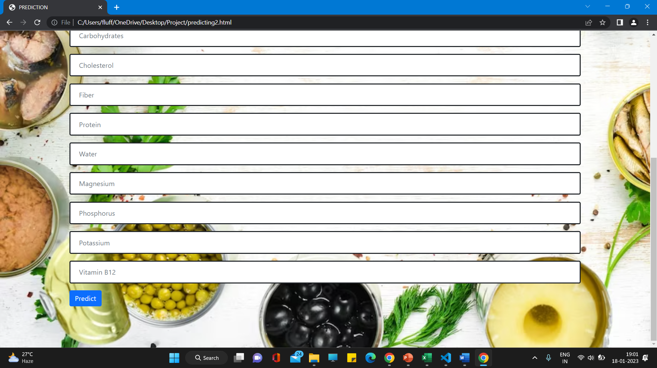
Predicting Page:

Slide 40
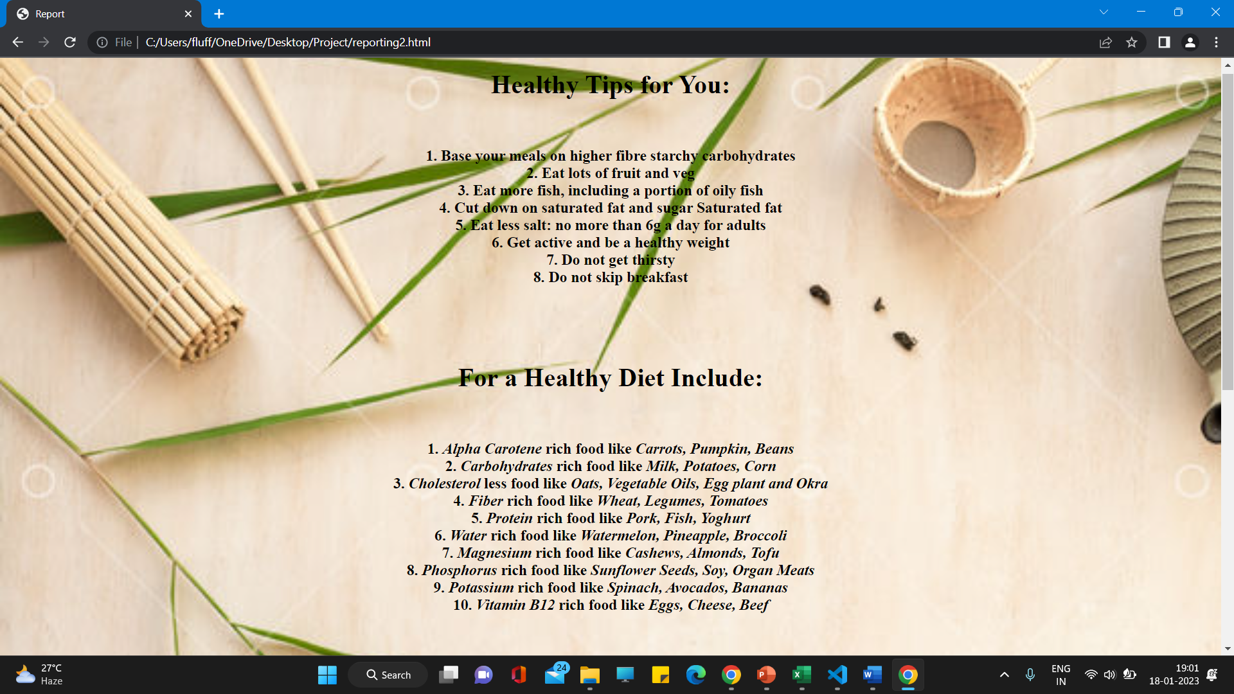
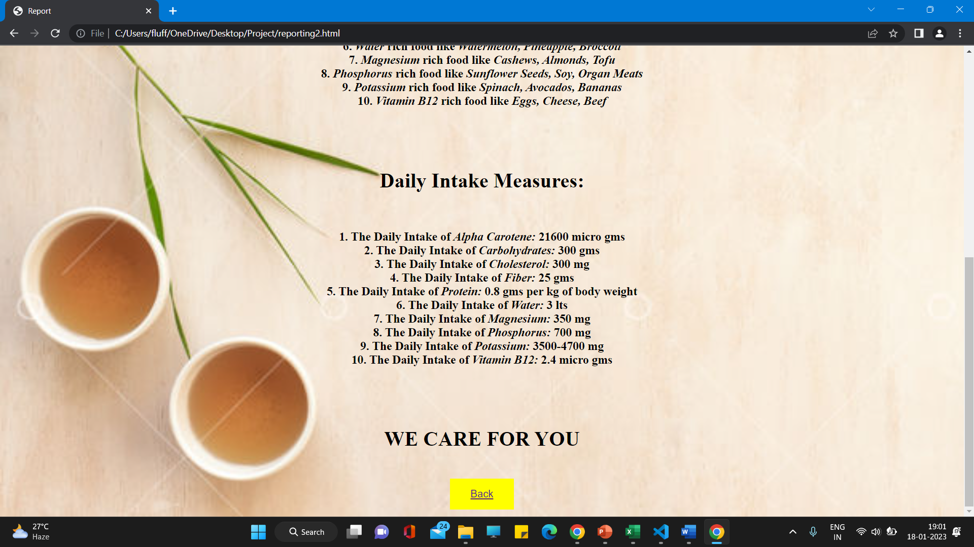
Precautions page:

Slide 41
CONCLUSION
This study identifies and evaluates ML models for the monitoring and prediction of food safety. A systematic literature search yielded 114 relevant studies, 75% of which had been published in the last 5 years.
The use of ML models within the context of food safety monitoring and prediction is thus still in its early stage but increasing rapidly.
The predictive accuracy of the retrieved studies is high, indicating that ML models offer a promising method with regard to the monitoring and prediction of food safety.
The suggestions for data sources and input variables identified in this study suggest several avenues for future studies applying ML models for the monitoring and prediction of food safety.

Slide 42
Future Scope
This study has shown many promising applications of ML application in the context of food safety monitoring and prediction.
However, the proposed studies mostly used one ML model for making food safety predictions. A few studies made comparisons among several ML. models on the same dataset.
Making comparisons among MLS could improve the opportunity of obtaining a better result of prediction. In addition, some studies used data from only one data source.

Slide 43
Table for student contribution
Sno | TASKS | 19A91A0559 | 19A91A0538 | 19A91A0536
1 | Literature Survey
2 | Problem Formulation
3 | Requirements gathering
4 | Resource Estimation
5 | Documentation
6 | PPT Preparation

Slide 44
References
https://www.researchgate.net/publication/343236511_Machine_Learning_Based_Approach_on_Food_Recognition_and_Nutrition_Estimation
Machine learning based approach on Food recognition and nutrition estimation.
https://www.irjet.net/archives/V8/i4/IRJET-V8I4702.pdf
Website on diet recommendation using Machine learning.
https://ift.onlinelibrary.wiley.com/doi/epdf/10.1111/1541-4337.12868
Application of machine learning to monitor and prediction of food safety:A review
Overview of Google Collaboratory
https://research.google.com/colaboratory/faq.html#:~:text=Colaboratory%2C%20or%20%E2%80%9CColab%E2%80%9D%20for,learning%2C%20data%20analysis%20and%20education.

